Slide 1

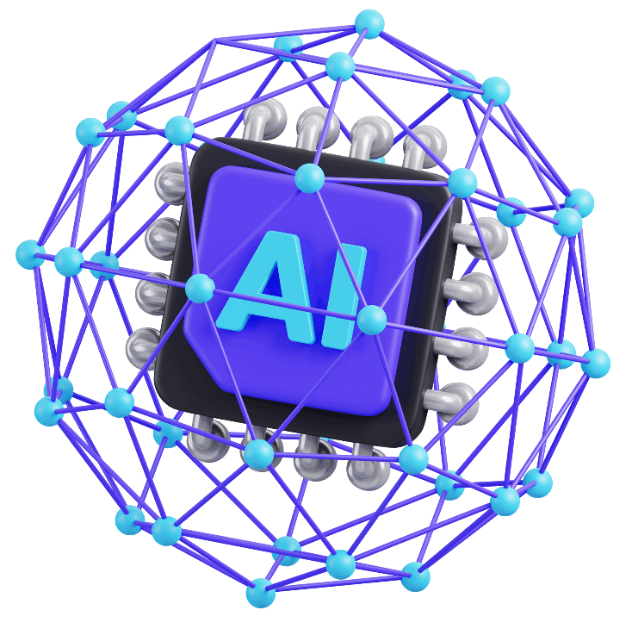
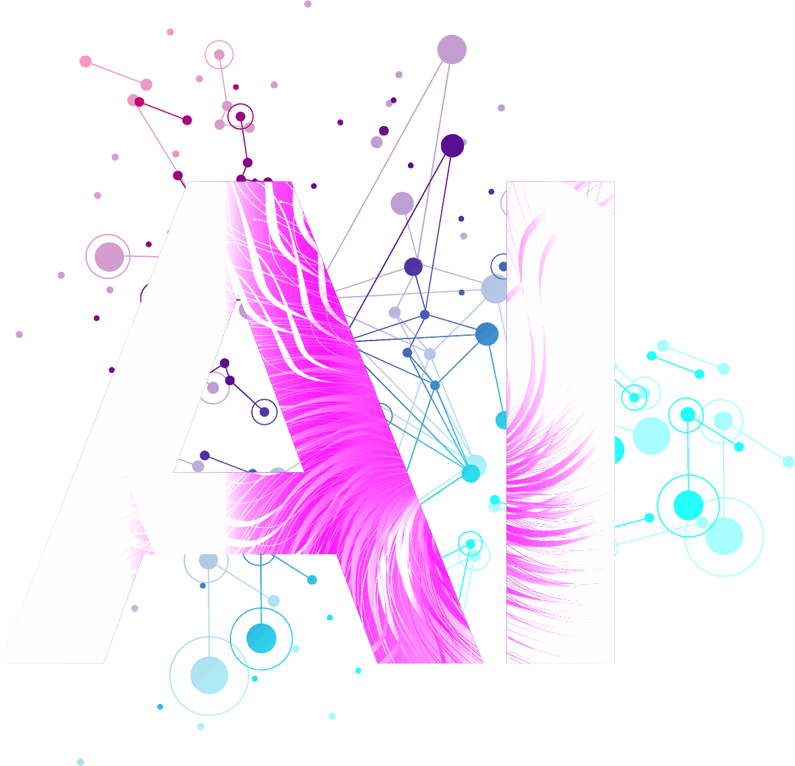

Generative AI

Slide 2
Table Of Contents
01
Introduction
05
Security Challenges
02
What is Generative AI
06
Applications Of Tools Based On LLM
03
Generative AI Models
07
Future Of Generative AI
04
Generative AI Statistics
08
Conclusion

Slide 3
Introduction
Artificial Intelligence
Machine Learning
Deep Learning
Artificial Intelligence (AI) simulates human intelligence. Machine Learning (ML) enables AI systems to learn from data. Deep Learning, a subset of ML, powers sophisticated neural networks for complex tasks in Generative AI.

Slide 4




Types Of Machine Learning Models
Supervised
Learning
Learns from labeled data, predicting labels for new data based on established feature label relationships.
Unsupervised Learning
Adapts to unlabeled data, revealing inherent patterns and structures without predefined labels.
Reinforcement Learning
Evolves through environment interactions, refining strategies over time based on feedback for continual performance improvement.
Classification Models
Predict data point categories, such as determining if an email is spam or not, based on learned patterns.

Slide 5
Summary
Artificial Intelligence
Machine Learning
Supervised Learning
Unsupervised Learning
Reinforcement Learning
Discriminative Models
Generative Models
Generative Models
Shallow Models
Deep Models
Shallow Models
Deep Models
Deep Models
Shallow Models
Logistic Regression
CNNS, RNNS
Naive Bayes
Conditional Variational Autoencoders (CVAES)
Autoencoders
Gaussian Mixture Models

Slide 6

What is Generative AI
Generative AI creates content autonomously, mimicking human creativity. It generates text, images, or other data, revolutionizing various industries with its innovative and dynamic capabilities.

Slide 7
What Are Large Language Models?
Large Language Models are advanced AI systems, designed to understand and generate human-like text. They leverage massive neural networks for versatile language comprehension and generation.
Text output
Language Model
Text Input
Numeric representation of text useful for others systems

Slide 8

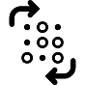


Generative AI Models
Variational Autoencoders
Generative Adversarial Networks
Transformer Models
Generative Adversarial Networks
Hybrid Generative AI
Transformer Models
Hybrid Generative AI
Hybrid Generative AI

Slide 9
Generative Vs. Discriminating Model
Generative models create new data, simulating patterns from learned examples. Discriminative models classify input data into predefined categories based on learned features, distinguishing between classes.
Generative
Discriminating Model

Slide 10
Transformer-based Model
Transformer-based models, revolutionize natural language processing with self-attention mechanisms, enabling context-aware understanding and generation, and excelling in diverse language tasks.
Attention
Dense
*N
*N
Recurrent Layer
Recurrent Layer
Embedded
Embedded
Sources
Targets

Slide 11
Generative Adversarial Networks(GAN)
Generative Adversarial Networks (GANs) are AI models comprising a generator and discriminator. It engage in a competitive process, fostering dynamic creation and realistic discrimination of data.
Noise
Generator
Fake Sample
Discriminator
Real

Slide 12



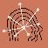




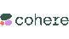

Generative AI Tools
Generative AI Tools
Duet Al
Duet Al
Synthesia
GPT-4
Claude
ChatGPT
Scribe
Dall-E2
AlphaCode
G Bard
Cohere Generate
GitHub Copilot

Slide 13
Applications Of Tools Based On LLM
 | Tools/Applications | Description
Content Generation | GPT-3 Playground | An online platform that allows users to interact with OpenAI's GPT-3 language model.
 | Hugging Face Transformers | A library providing pre-trained language models for various natural language processing tasks.
Language Translation | Google Cloud Natural Language API | An API providing language analysis and translation features in the cloud.
 | Microsoft Azure Cognitive Services | A collection of cloud-based services, including Text Translator, for language translation features.
Sentiment Analysis | Google Cloud Natural Language API | Employs sentiment analysis to comprehend sentiments expressed in textual data.
 | IBM Watson Natural Language Understanding | A cognitive service that offers sentiment analysis and other language understanding features.
Code Completion | OpenAI Codex | An AI model trained on a large codebase, capable of providing code completion suggestions and snippets.
Image and Video Generation | TensorFlow with GANs, DCGANs, and VAEs | A deep learning framework with tools and libraries for building and training generative models.
 | NVIDIA StyleGAN | Another deep learning framework offering capabilities for image and video generation.
 | NVIDIA StyleGAN | A framework developed by NVIDIA for generating high-quality images, including deepfake videos.
Music and Art | Magenta | An open-source project by Google that explores machine learning for music generation and composition.
 | DeepArt | An application utilizing deep learning algorithms for artistic image generation in various styles.
 | MuseNet | An AI model developed by OpenAI for generating original music compositions across different genres.

Slide 14
Generative AI Applications
Generative AI, a subset of artificial intelligence dedicated to content creation, finds diverse applications across industries. Here are key areas where its impact is notable:
Content Creation
Simulation and Gaming
Art and Design
Code Generation
Language Translation
Data Augmentation
Chatbots and Virtual Assistants
Creative Writing Assistance
Drug Discovery
Personalization in Marketing

Slide 15
Generative AI Statistics
Leading generative AI tools used for marketing purposes by professionals in the US as of March 2023
Rate of generative AI adoption in the workplace in the US 2023, by industry

Slide 16

Limitations Of Generative AI Models
Content quality
Computational requirements
Prejudice and fairness Generative
Explainability and Interpretability
Security and protection
Lack of Common Sense

Slide 17
Security Challenges
1
2
3
4
Adversarial Attacks
Malicious input manipulation can deceive models, posing risks in sensitive applications like cybersecurity and finance.
Bias and
Fairness
Inherent biases in training data may lead to unfair outcomes, impacting marginalized groups negatively.
Data Privacy Concerns
Generating content may inadvertently reveal private information, raising ethical and legal privacy concerns.
Model
Misuse
Generative models can be exploited for malicious purposes, necessitating robust safeguards against misuse and manipulation.

Slide 18

Ethical Considerations In Generative AI
Transparency and Accountability
Ensuring clear understanding and responsibility in model decision-making processes.
Responsible Use
Adhering to ethical guidelines to prevent unintended harm and misuse.
Bias Mitigation
Counteracting biases in training data for fair and equitable outcomes.
Privacy Preservation
Safeguarding individuals' private information during generative AI applications.

Slide 19
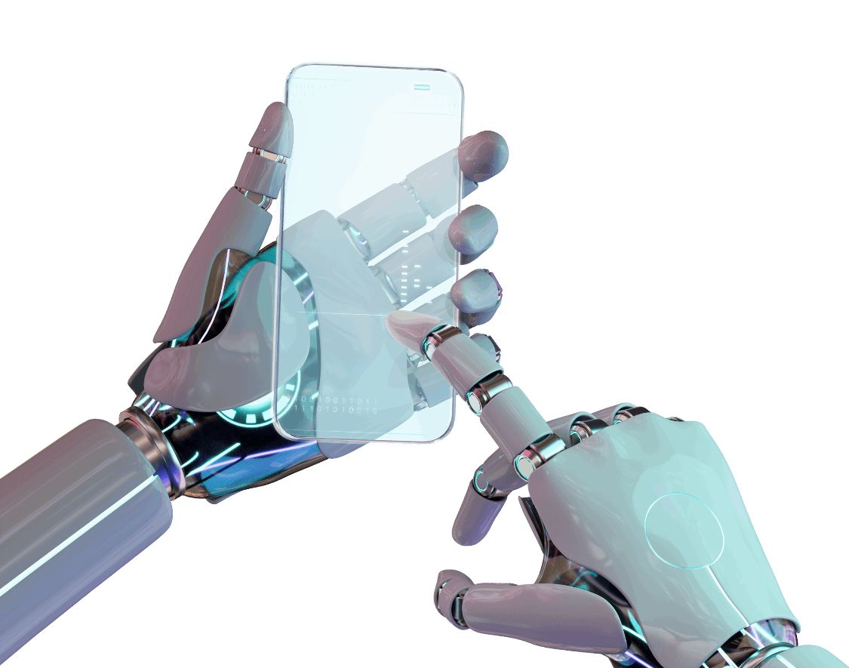
Future Of Generative AI
The future of Generative AI holds breakthroughs in creativity, problem-solving, and human-computer interaction, revolutionizing industries and fostering innovation across diverse applications.

Slide 20

Conclusion
The future of Generative AI holds breakthroughs in creativity, problem-solving, and human-computer interaction, revolutionizing industries and fostering innovation across diverse applications.

Slide 21
Icons

Slide 22
Icons

Slide 23
How To Edit Shapes
You can add and edit some shapes to your presentation to present your data in a visual way.
Choose your favourite infographic and insert it in your presentation using Ctrl C + Ctrl V or Cmd C + Cmd V in Mac.
Select one of the parts and ungroup it by right-clicking and choosing “Ungroup”.
Change the color by clicking on the paint bucket.
Then resize the element by clicking and dragging one of the square-shaped points of its bounding box (the cursor should look like a double-headed arrow). Remember to hold Shift while dragging to keep the proportions.
Group the elements again by selecting them, right-clicking and choosing “Group”.
Repeat the steps above with the other parts and when you’re done editing, copy the end result and paste it into your presentation.
Remember to choose the “Keep source formatting” option so that it keeps the design. For more info, please visit Slideegg (Tips & Tricks).

Slide 24
Terms Of Use (Free Users)
If you are a free subscriber, you should credit SlideEgg by keeping the
“Thank You” slide.
Kindly refer to the following slide for the Terms of Use for premium users.
You can:
Customize or edit this template
Use this template for both business and personal endeavors.
You can not:
Sell, rent, or second-license SlideEgg content or its altered version. Promulgate, unless explicitly permitted, SlideEgg content, by SlideEgg.
Incorporate SlideEgg content in any database or file online or offline.
Obtain SlideEgg content’s copyright.
Kindly refer to our Tutorial page or FAQ for advanced slide modification guidelines.

Slide 25
Terms Of Use (Premium Users)
Being a premium subscriber, you have the privilege of using this PPT template
without giving attribution to SlideEgg or keeping the “Thank You” slide.
You can:
Customize or edit this template.
Use this template for both business and personal endeavors.
Circulate or share the editable format of this template with anyone you want.
You can not:
Sell, rent or second-license SlideEgg content or the altered version of it. Promulgate or include the templates in any other services database
that performs as distribution or resale platform, unless explicitly permitted, by SlideEgg.
Incorporate the elements used in SlideEgg’s templates separately.
Obtain SlideEgg’s copyright for the elements used in this template as a logo or trademark.
Kindly refer to our Tutorial page or FAQ for advanced slide modification guidelines.

Slide 26






Thank You!
We respect your valuable time with SlideEgg!
If you have any questions, please reach us
Do you have a design request, please visit our Deckez site.
CREDIT: SlideEgg created this PowerPoint template.
Let this slide be kept for attribution.
www.slideegg.com

